Slide 1
Logistic Regression
Sourav Karmakar
souravkarmakar29@gmail.com

Slide 2
Outline
Why Linear Regression model is not suitable for classification problem
Towards Logistic Regression for Binary Classification
The Logistic function and its derivative
The hypothesis of Logistic Regression
The Cost Function of Logistic Regression
Gradient Descent Optimization applied to Logistic Regression
The Decision Boundary of Logistic Regression
Multiclass Classification

Slide 3
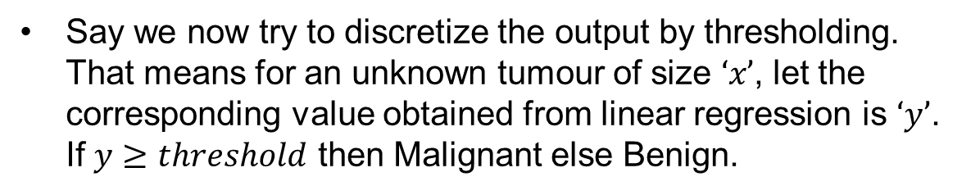

Why Linear Regression is not suitable for Classification
Consider a classification problem where we are trying to classify a Tumour to be Benign or Malignant based on its Size.
We gather data on various Tumours and label them as 0 (benign) or 1 (Malignant). If we plot these data we see something like following.
Lets see what will happen if we put a Linear Regression line through our observed data.
Malignant?
(y)
First problem that we observe is that, the linear regression produces continuous output which is more suitable when target variable is quantitative in nature. However, here the target variable is discrete.
1
0.5
Say we now try to discretize the output by thresholding. That means for an unknown tumour of size $‘x’$, let the corresponding value obtained from linear regression is $‘y’$. If $y≥threshold$ then Malignant else Benign.
0
$$x_{t}$$
Size (x)
This creates another problem of too many errors while classifying because determination of threshold is not trivial and intuitive in this case.

Slide 4
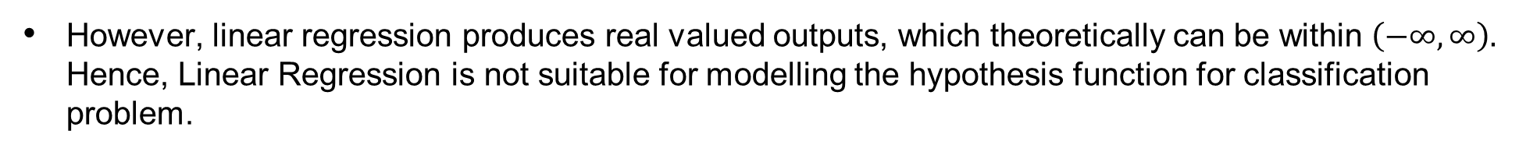
Why Linear Regression is not suitable for Classification
In classification problem we are more interested to learn the conditional probability $P\left(y=1 | x\right)$ (i.e. Probability of target to be $1$ given the value of the input variable $x$)
Hence, our hypothesis function should produce legitimate probability value as output, i.e. provide output between [0,1].
However, linear regression produces real valued outputs, which theoretically can be within $\left(−∞, ∞\right).$ Hence, Linear Regression is not suitable for modelling the hypothesis function for classification problem.

Slide 5
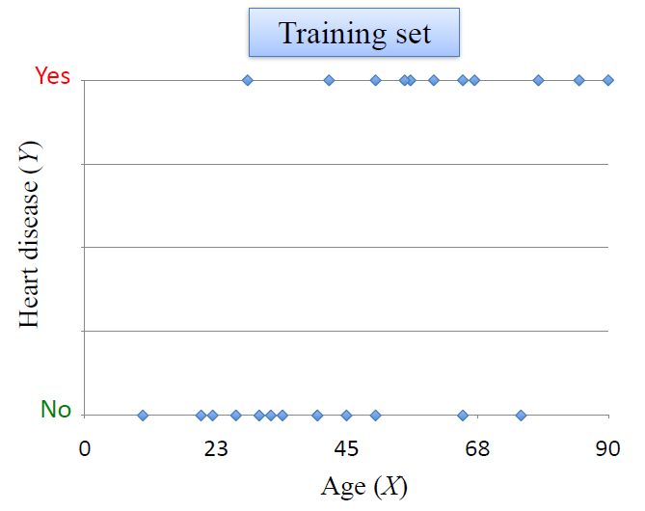
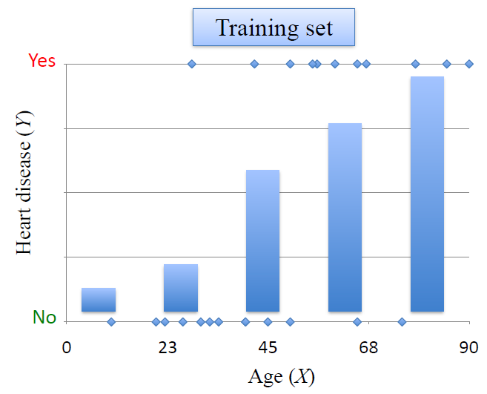
Example of estimating conditional probability from Data
Consider the following Scenario of Heart Disease vs. Age:
Task: Given a new person’s age, predict if he/she has heart disease. Hence, mathematically speaking, our task is to estimate P(Y = Yes | X)
First Calculate P(Y = Yes | X) for different values of X
Then fit a curve that estimates the probability P(Y = Yes | X)

Slide 6
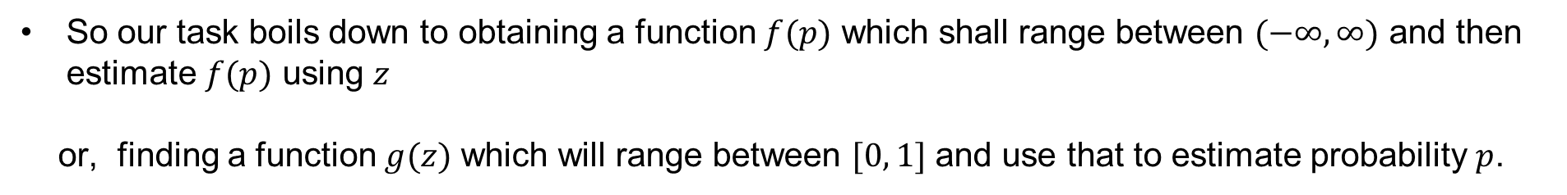
Towards Logistic Regression for Binary Classification
In real life scenario we usually have multiple predictor variable. Let’s denote them by $x_{1}, x_{2}, …, x_{k}$
If we linearly combine these predictors we get: $z =θ_{0}+θ_{1} x_{1}+θ_{2} x_{2}+…+θ_{k} x_{k}$
This is the formulation of linear regression. As we know $z$ shall range within $(−∞, ∞)$
But, in Logistic Regression the output shall be a legitimate probability value $p$ which shall range from $[0, 1]$
So our task boils down to obtaining a function $f(p)$ which shall range between $(−∞, ∞)$ and then estimate $f(p)$ using $z$
or, finding a function $g(z)$ which will range between $[0, 1]$ and use that to estimate probability $p$.
It is worth noting that, $g\left(f\left(p\right)\right)=g\left(z\right)=p .$ Hence mathematically $g and f$ are inverse functions of one another.

Slide 7
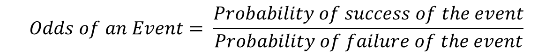
Towards Logistic Regression for Binary Classification
In many situations, instead of using explicit probability of an event we use odds. For example, odds of India winning a match against Australia is 3 to 4. The odds of an event is defined by
$$Odds of an Event= \frac{Probability of success of the event}{Probability of failure of the event}$$
If probability of success of an event is $p$, then odds of the event is $odds= \frac{p}{1−p}$
As $p∈[0, 1]$, $odds= \frac{p}{1−p}∈\left[0, ∞\right) , odds=0 when p=0 and odds→∞ when p→1$
Now if we take natural logarithm of odds, $\ln{(odds) }=\ln{\frac{p}{1−p}∈ (−∞, ∞)}$.
However it is undefined when $p=0$
So, $f\left(p\right)=\ln{\frac{p}{1−p}}$ is one such function which ranges between $(−∞,∞)$ and can be estimated using $z=θ_{0}+θ_{1} x_{1}+θ_{2} x_{2}+…+θ_{k} x_{k}$

Slide 8
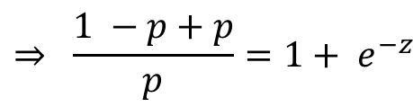
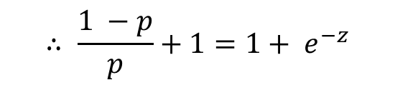
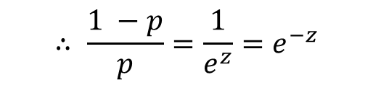
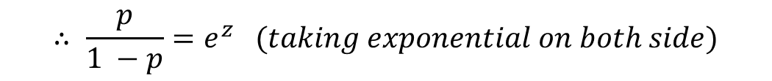
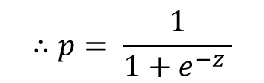

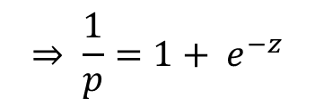
Towards Logistic Regression for Binary Classification
So we got a function $f\left(p\right)=\ln{\frac{p}{1−p}}$ which ranges between $(−∞,∞)$ and can be faithfully estimated using $z=θ_{0}+θ_{1} x_{1}+θ_{2} x_{2}+…+θ_{k} x_{k}$
$$z=\ln{\frac{p}{1−p}}$$
$$∴ \frac{p}{1 −p}=e^{z} (taking exponential on both side)$$
$$∴ \frac{1 −p}{p}=\frac{1}{e^{z}}{=e}^{−z}$$
$$∴ \frac{1 −p}{p}+1{=1+ e}^{−z}$$
$$⇒ \frac{1 −p+p}{p}{=1+ e}^{−z}$$
$$⇒ \frac{1}{p}{=1+ e}^{−z}$$
$$∴p= \frac{1}{1+e^{−z} }$$
So we obtained $g\left(z\right)= \frac{1}{1+e^{−z}}$ which provides output between $(0, 1)$
This is known as Logistic or Sigmoid function

Slide 9
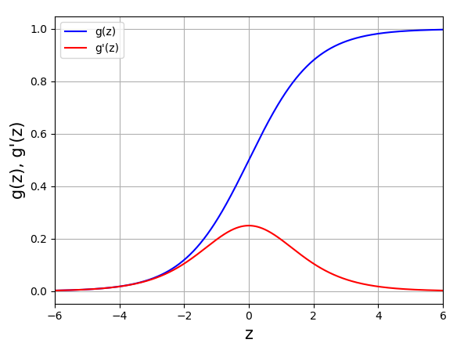
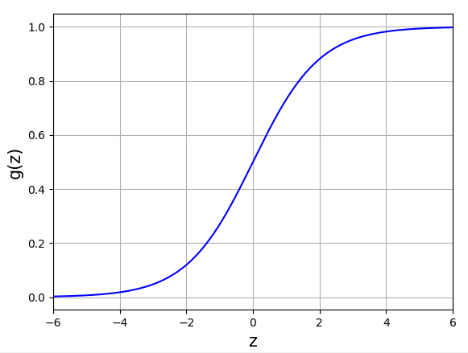
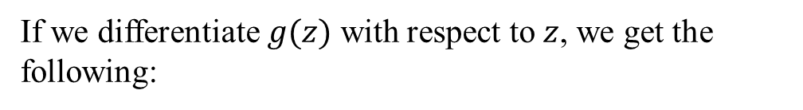
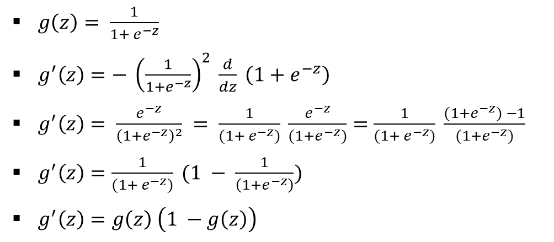
The Logistic Function and its derivative
The Logistic Function, also known as the Sigmoid Function is defined by:

Slide 10
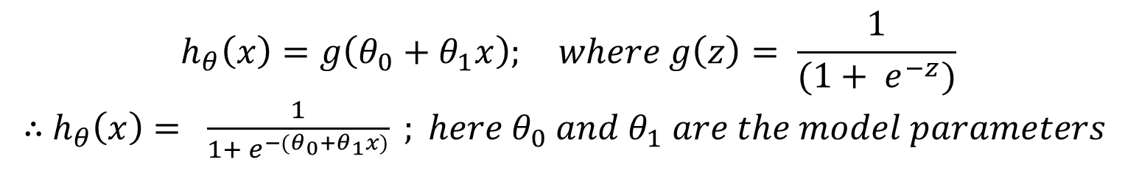
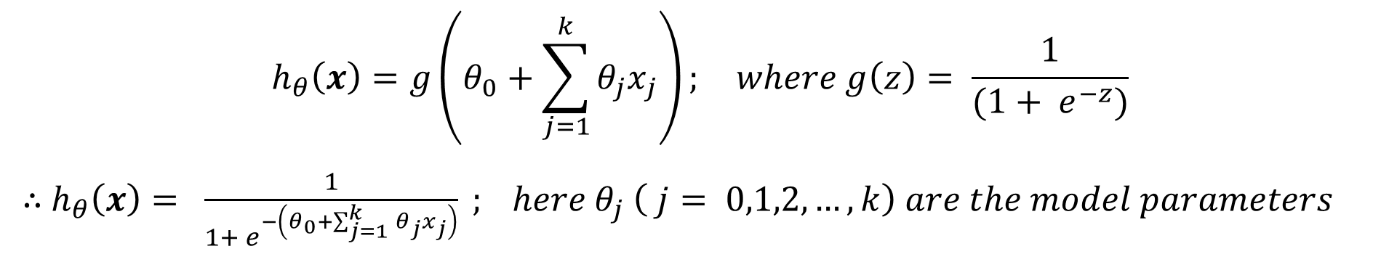
Hypothesis of Logistic Regression

Slide 11
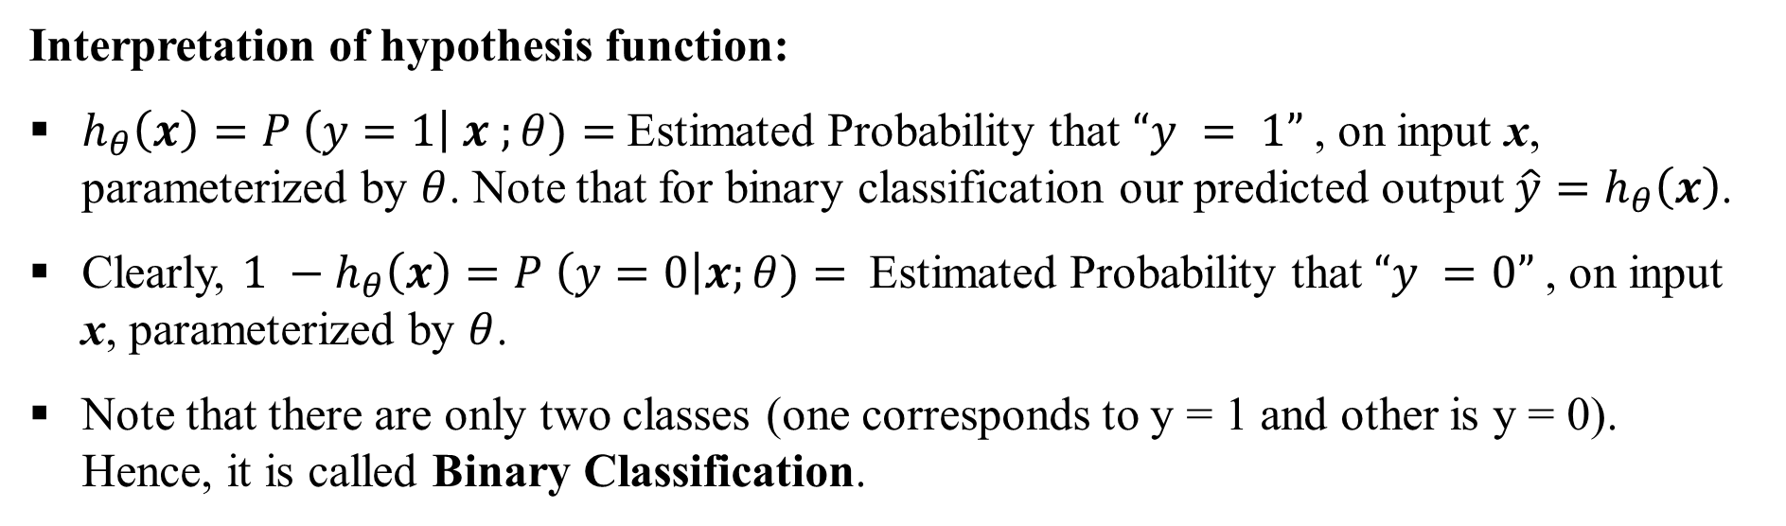
Hypothesis of Logistic Regression

Slide 12



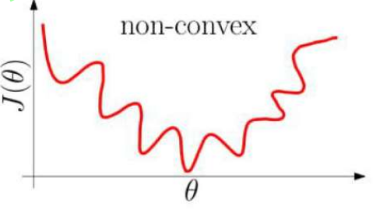
The Cost Function
If we use the Mean Square Error (MSE) cost function, then for individual observation:
Then the overall cost function:
Problem with MSE cost function in classification problem is that it has many local minima. i.e. MSE cost function becomes non-convex in classification problem.
If cost function has many local minima then optimizing the same using gradient descent is difficult. Because gradient descent being a convex optimization algorithm is susceptible to local minima.
Hence we need different cost function for classification problem.

Slide 13
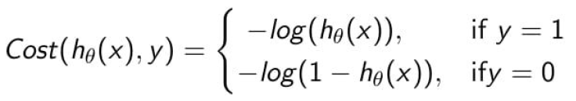
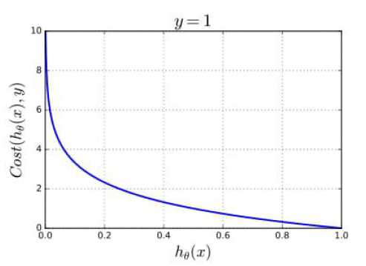
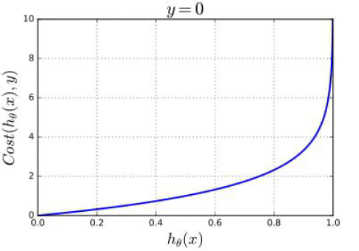
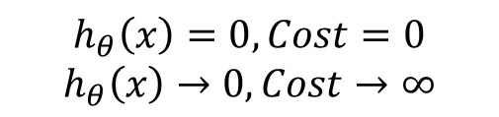
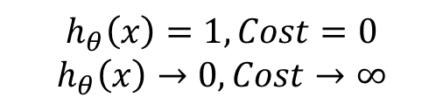
The Cost Function
The cost function of for Binary Classification problem has following form:
Interpretation of the cost function:
$$h_{θ}\left(x\right)=1, Cost=0$$
$$h_{θ}\left(x\right)→0, Cost→∞$$
$$h_{θ}\left(x\right)=0, Cost=0$$
$$h_{θ}\left(x\right)→0, Cost→∞$$

Slide 14
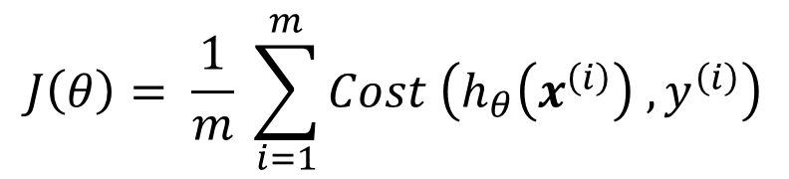
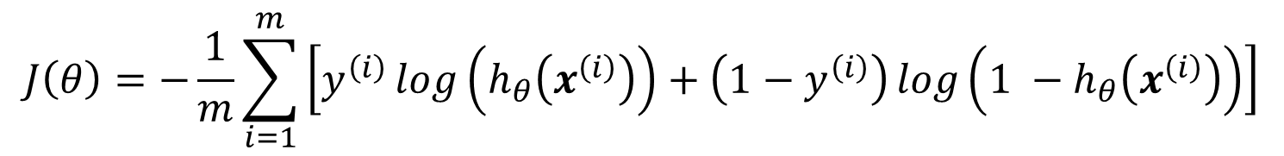


The Cost Function
We can express the cost function in Binary Classification as:
Now the overall cost function is nothing but average of individual cost functions:
Hence, in this case:
$$y_{p}^{(i)}$$
$$y_{p}^{(i)}$$
The predicted output
This is also called “Binary Cross-entropy Loss” or “Log-loss”

Slide 15
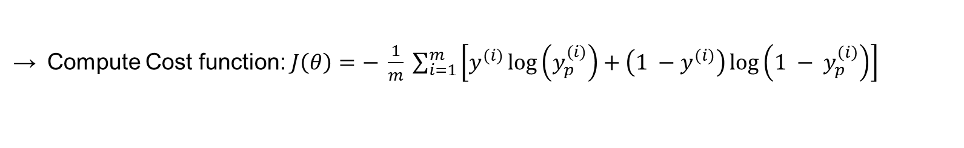
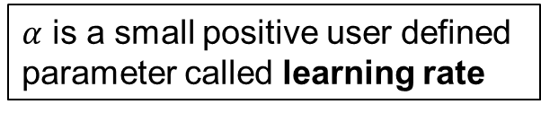
Gradient Descent Optimization
Algorithm: Gradient Descent (an optimization algorithm used to find minimum of convex functions)
Input: Feature set $\left(X={\left[\left\{x_{1}^{(i)}, x_{2}^{(i)},x_{3}^{(i)}, …,x_{k}^{(i)}\right\}\right]}_{i=1}^{m}\right)$ and corresponding target variables $\left(Y={\left[y^{\left(i\right)}\right]}_{i=1}^{m}\right)$
Output: Model parameters $Θ=\left[θ_{0}, θ_{1}, θ_{2}, …, θ_{k}\right]$ for which the cost function $J\left(θ\right)$ is minimum.
Initialisation: Initialise the model parameters $Θ=\left[θ_{0}, θ_{1}, θ_{2}, …, θ_{k}\right]$ with random numbers.
Initialise iteration counter: $t ←1$
Repeat until Convergence {
Compute Cost function: $J\left(θ\right)=− \frac{1}{m} \sum_{i=1}^{m}{\left[y^{(i)}\log\left(y_{p}^{(i)}\right)+\left(1 −y^{(i)}\right)\log\left(1 − y_{p}^{\left(i\right)}\right)\right]}$
Compute the gradient of Cost function: $∇J\left(θ\right)= \frac{∂}{∂θ} J\left(θ\right)$
Update the model parameters: $θ\left(t+1\right)=θ\left(t\right) −α ∇J\left(θ\right)$
$α$ is a small positive user defined parameter called learning rate
Increment the iteration counter: $t ←t+1$
}

Slide 16





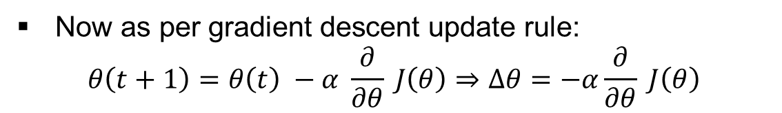
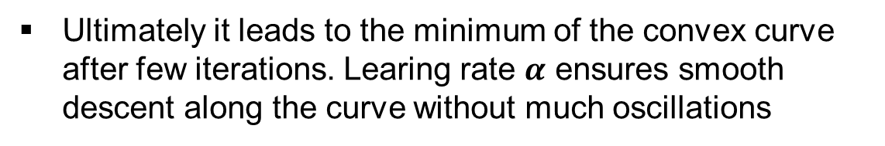
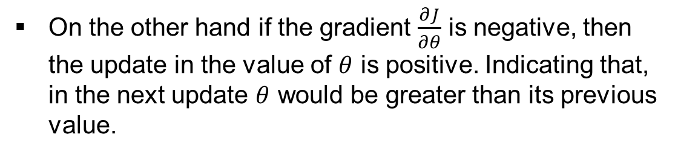
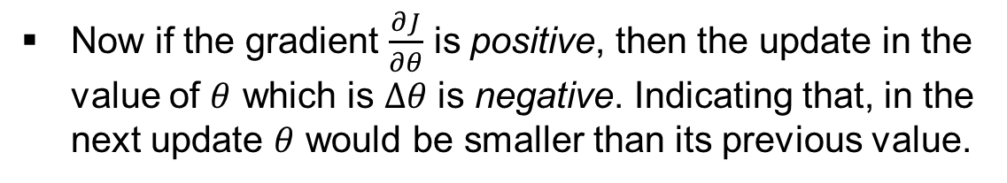
Intuition of Gradient Descent Algorithm
The plot of cost function with respect to any of the model parameters (considering the other parameters fixed) is convex in nature as shown below.
Now as per gradient descent update rule:
$$θ\left(t+1\right)=θ\left(t\right) −α \frac{∂}{∂θ} J\left(θ\right)⇒∆θ=−α\frac{∂}{∂θ} J\left(θ\right)$$
Now if the gradient $\frac{∂J}{∂θ}$ is positive, then the update in the value of $θ$ which is $∆θ$ is negative. Indicating that, in the next update $θ$ would be smaller than its previous value.
On the other hand if the gradient $\frac{∂J}{∂θ}$ is negative, then the update in the value of $θ$ is positive. Indicating that, in the next update $θ$ would be greater than its previous value.
Ultimately it leads to the minimum of the convex curve after few iterations. Learing rate $α$ ensures smooth descent along the curve without much oscillations

Slide 17

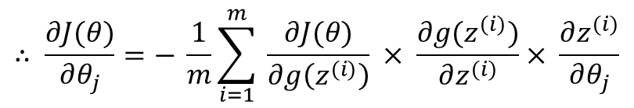
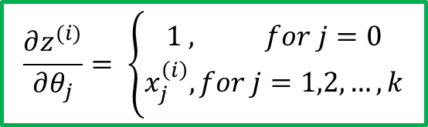
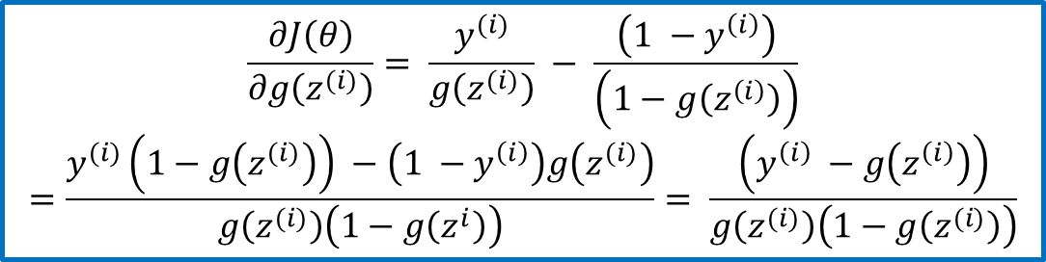
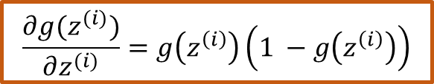
Gradient Descent Optimization applied to Logistic Regression
Proof of this is already provided in the slide where we discussed about logistic function

Slide 18
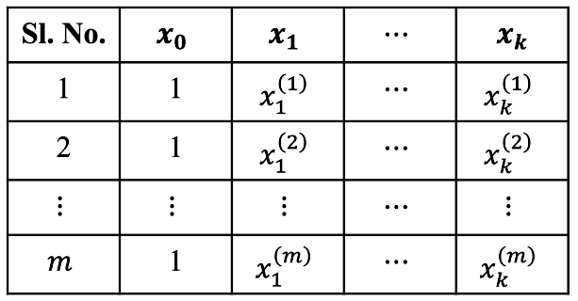
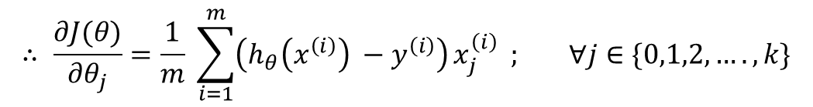
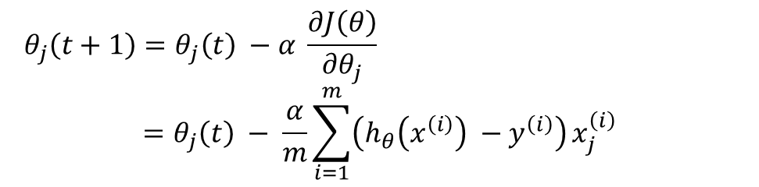
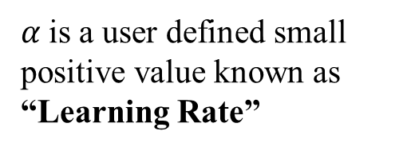

Gradient Descent Optimization applied to Logistic Regression
This can be obtained by adding a feature column with all values 1 to the left of the dataset table.
Therefore the Gradient descent update rule is:

Slide 19
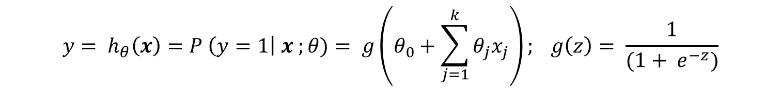
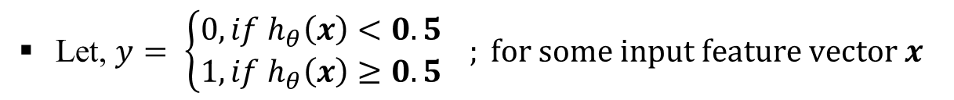
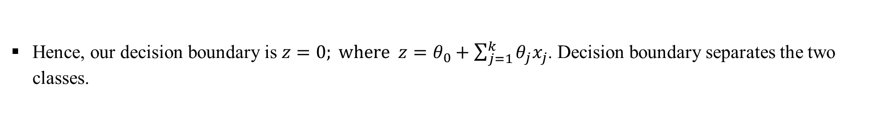

Decision Boundary of Logistic Regression
This is a binary classification with y = 0 (for class-1) or 1 (for class-2)
, Because $g\left(z\right)= \frac{1}{\left(1+e^{−z}\right)}=0.5 when z=0$

Slide 20

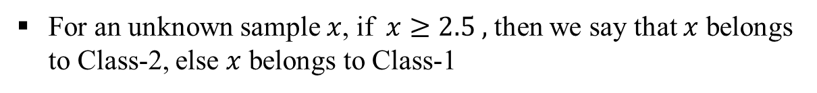
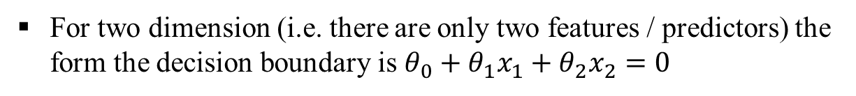

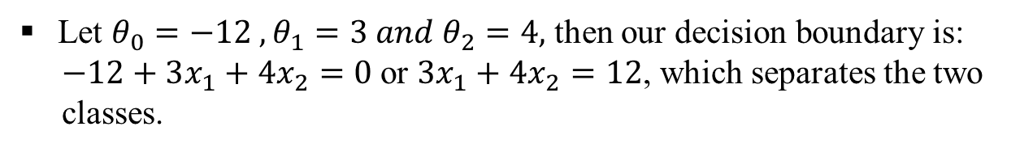
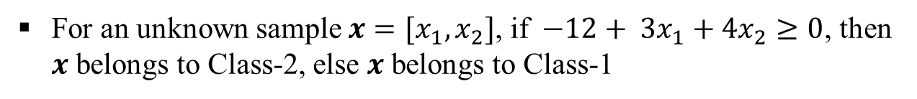

Decision Boundary of Logistic Regression
Class-1
Class-2
1
2
3
4
Class-1
3
Class-2
Consider the example beside. There are two classes (Class – 1 and Class – 2)
2
1
1
2
3
4

Slide 21
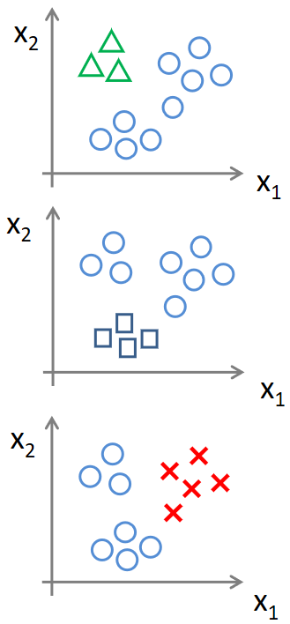

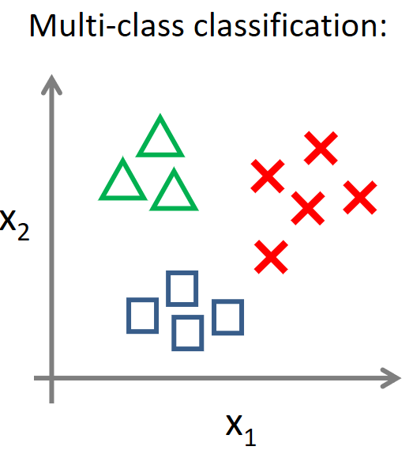





MULTICLASS CLASSIFICATION

Slide 22
Thank You

